Slide 1
K- Nearest Neighbor (KNN) Instance Based Learning

Slide 2
Introduction
Instance-based learning is often termed lazy learning, as there is typically no “transformation” of training instances into more general “statements”
Instead, the presented training data is simply stored and, when a new query instance is encountered, a set of similar, related instances is retrieved from memory and used to classify the new query instance
Hence, instance-based learners never form an explicit general hypothesis regarding the target function. They simply compute the classification of each new query instance as needed

Slide 3
k-NN Approach
The simplest, most used instance-based learning algorithm is the k-NN algorithm
k-NN assumes that all instances are points in some n-dimensional space and defines neighbors in terms of distance (usually Euclidean in R-space)
k is the number of neighbors considered

Slide 4
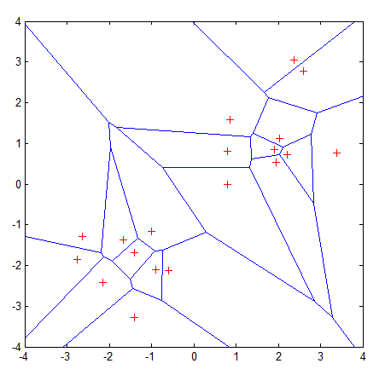
Graphic Depiction
Properties:
All possible points within a sample's Voronoi cell are the nearest neighboring points for that sample
For any sample, the nearest sample is determined by the closest Voronoi cell edge

